Slide 1

Number and Decimal Format Classes How to make your numerical data look good

Slide 2
Using the DecimalFormat class enables a program
to format numbers in a variety of ways
A DecimalFormat object is associated with a pattern when it is created using the new command
The object can then be used with the method format to create strings that satisfy the format
An object of the class DecimalFormat has a number of different methods that can be used to produce numeral strings in various formats

Slide 3
How to use Decimal Format
How to use Decimal Format
import java.text.DecimalFormat;
Instantiate a DecimalFormat object using a constructor which passes a String for the pattern:
DecimalFormat pricePattern = new DecimalFormat(“$0.00”);
Use the DecimalFormat class’s method format to format a number and return a String:
double price = 38.9555555
System.out.println(pricepattern.format(price));
Result: $38.55

Slide 4
Another Example
Create a DecimalFormat object to help format numbers – the default format gives 3 decimal places:
DecimalFormat formatter = new DecimalFormat( );
String pattern = “###,###.###”;
DecimalFormat formatter = new DecimalFormat( pattern);
String number = formatter.format(123456789.123);
number will look like: 123,456,789.123

Slide 5
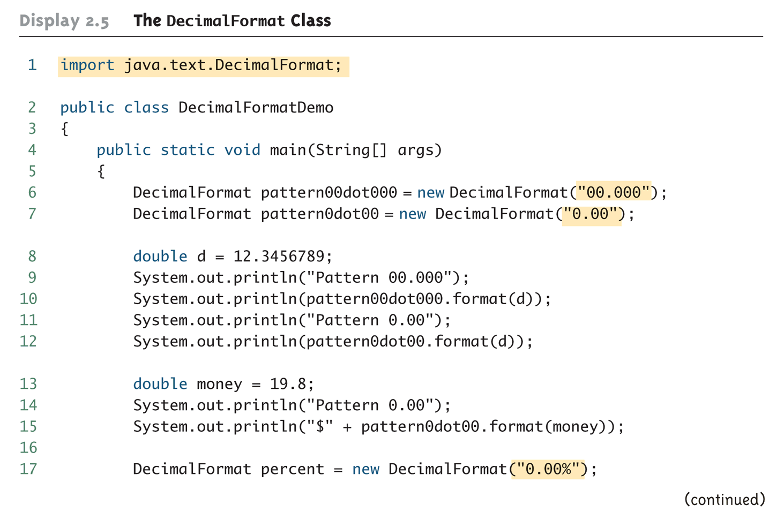
The DecimalFormat Class (Part 1 of 3)

Slide 6
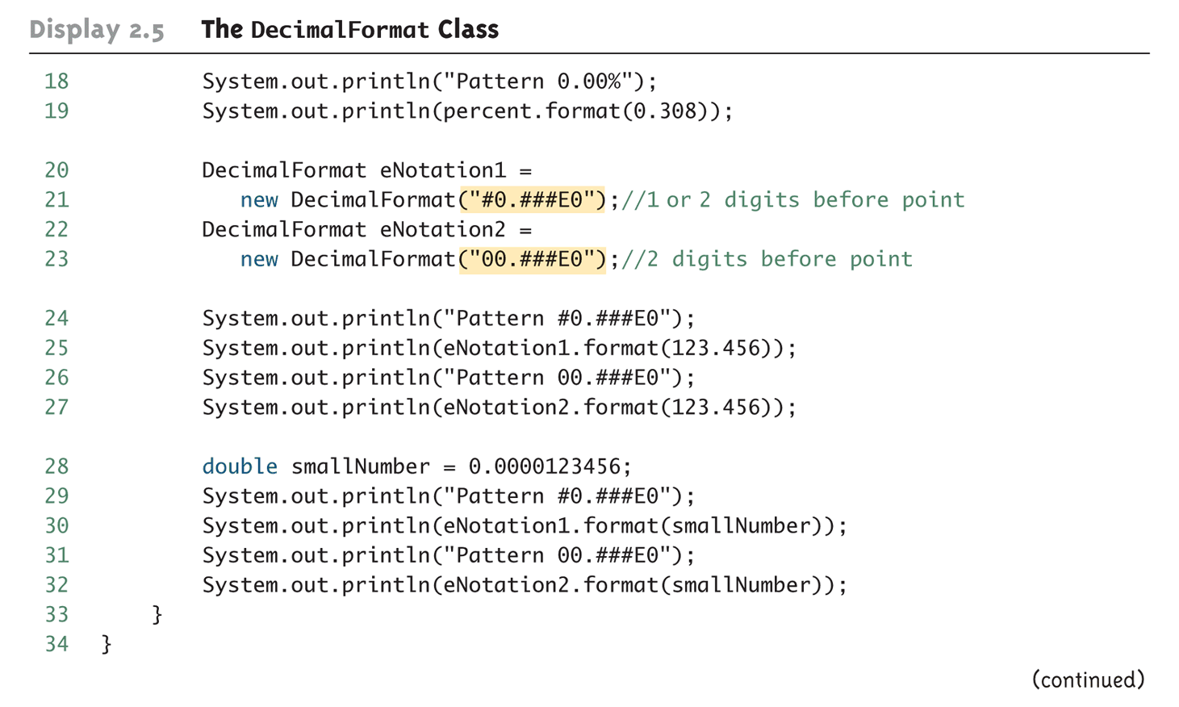
The DecimalFormat Class (Part 2 of 3)

Slide 7
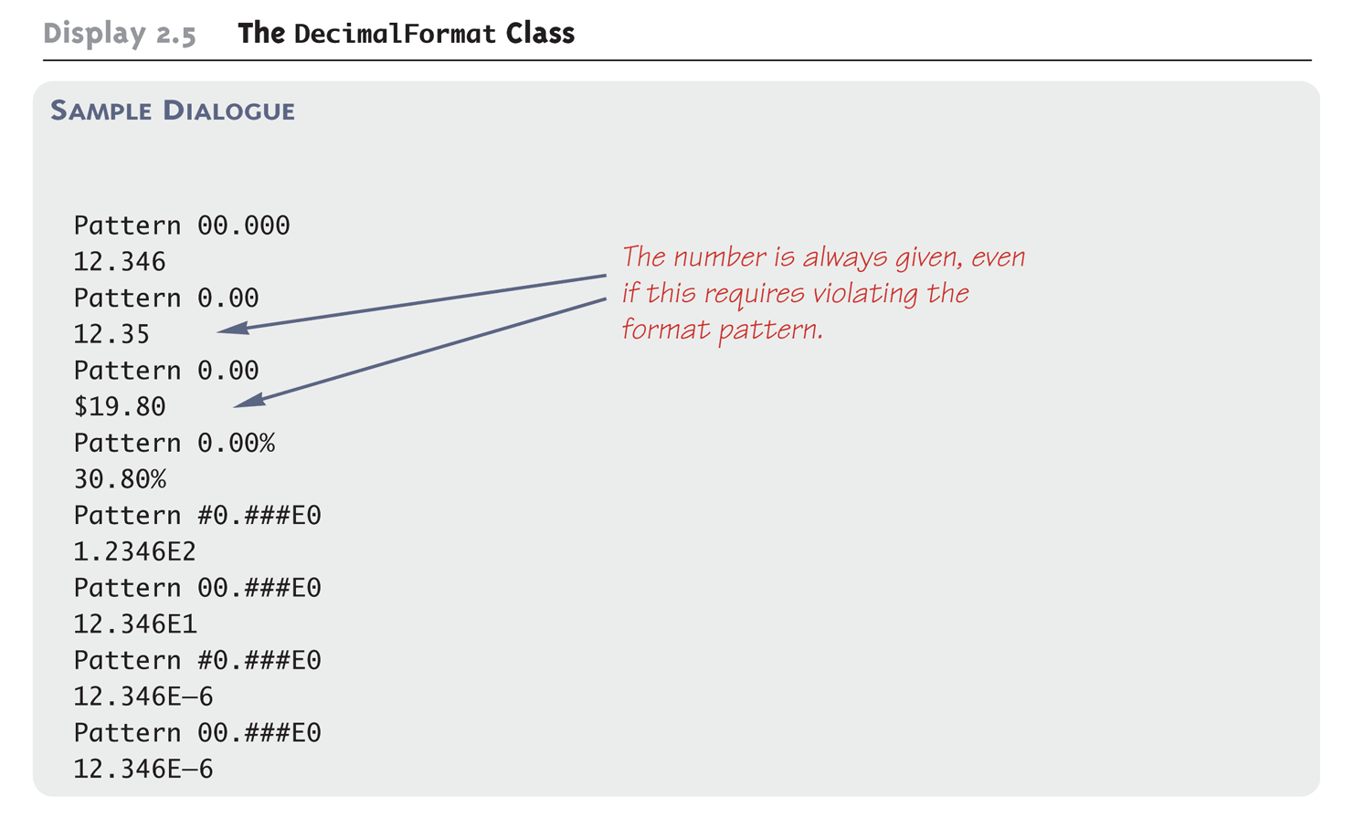
The DecimalFormat Class (Part 3 of 3)

Slide 8
Using the NumberFormat class enables a program
to output amounts of money using the appropriate
format
Using the NumberFormat class enables a program to output amounts of money using the appropriate format
import java.text.NumberFormat;
An object of NumberFormat must then be created using the getCurrencyInstance() method
The format method takes a floating-point number as an argument and returns a String value representation of the number in the local currency

Slide 9
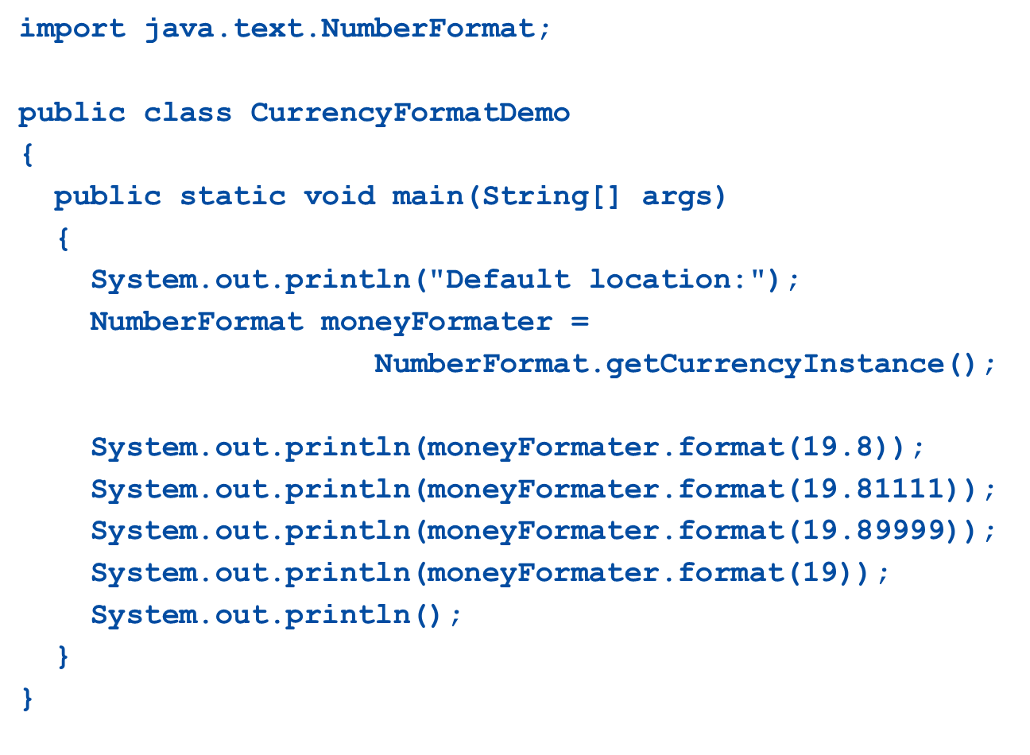
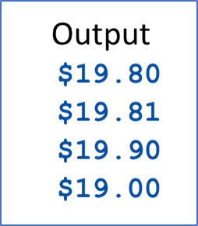

Slide 10
Number Format Pattern Syntax
0 A digit - always displayed, even if number has less digits (then 0 is displayed)
# A digit, leading zeroes are omitted.
. Marks decimal separator
, Marks grouping separator (e.g. thousand separator)
E Marks separation of mantissa and exponent for exponential formats.
; Separates formats
- Marks the negative number prefix
% Multiplies by 100 and shows number as percentage
? Multiplies by 1000 and shows number as per mille
¤ Currency sign - replaced by the currency sign for the Locale. Also makes formatting use the monetary decimal separator instead of normal decimal separator. ¤¤ makes formatting use international monetary symbols.
X Marks a character to be used in number prefix or suffix
' Marks a quote around special characters in prefix or suffix of formatted number.

